Slide 1
Reinforcement Learning To Solve Cart-Pole
Tyler Petty

Slide 2
Cart-Pole
http://gym.openai.com/envs/CartPole-v1/
Observation | Minimum | Maximum
Cart Position | -4.8 | 4.8
Cart Velocity | -Infinity | Infinity
Pole Angle | -24 degrees | 24 degrees
Pole Velocity at Tip | -Infinity | Infinity
Action | Value
Push cart left | 0
Push cart right | 1

Slide 3
Cart-Pole
Conditions
Terminates when:
Pole angle is more than 12 degrees from center
Cart position is more than 2.4 from center (cart reaches edge)
Episode length is greater than 200
Reward
+1 for every tick in episode
Goal
Achieve an average of 195 or greater on 100 trials

Slide 4
Cart-Pole
This Photo by Unknown Author is licensed under CC BY-SA

Slide 5
NEAT
Neural
Evolution
Of Augmenting
Topographies

Slide 6
NEAT
Developed by Ken Stanley in 2002 at University of Texas at Austin
Can generate a minimal neural network
Stated to perform faster than other neuro-evolutionary and reinforcement learning methods
Setup of network requires minimal alterations for different problems

Slide 7
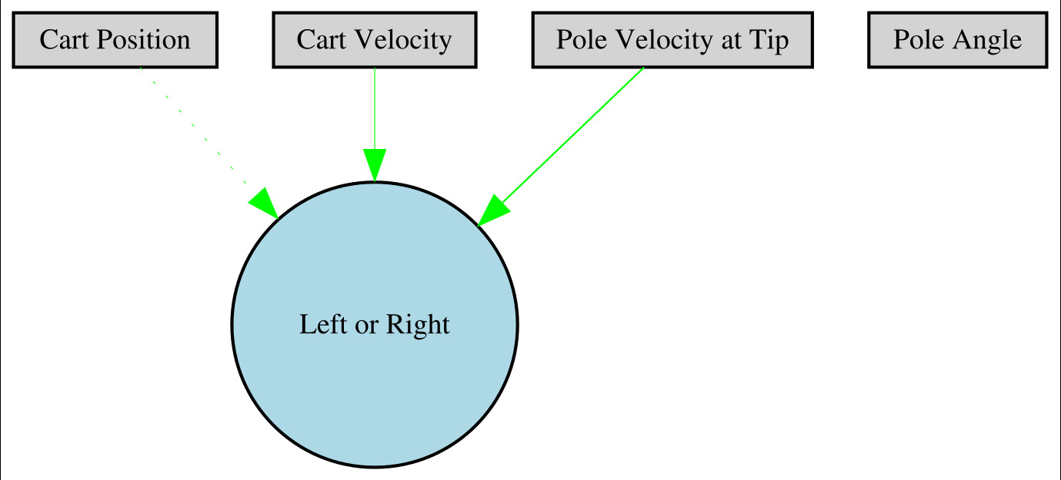
NEAT

Slide 8
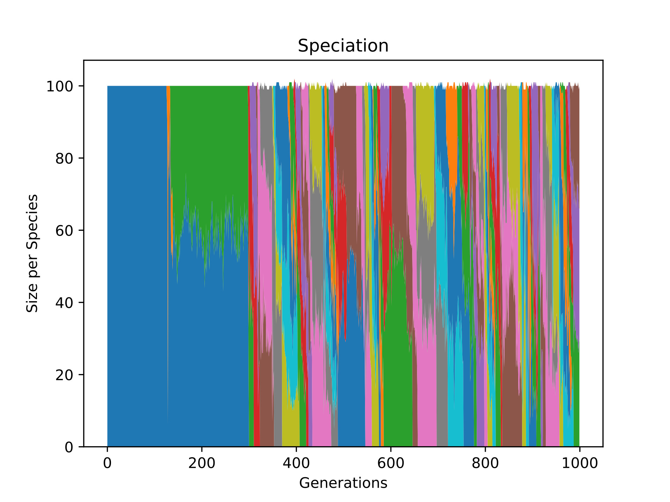
NEAT

Slide 9
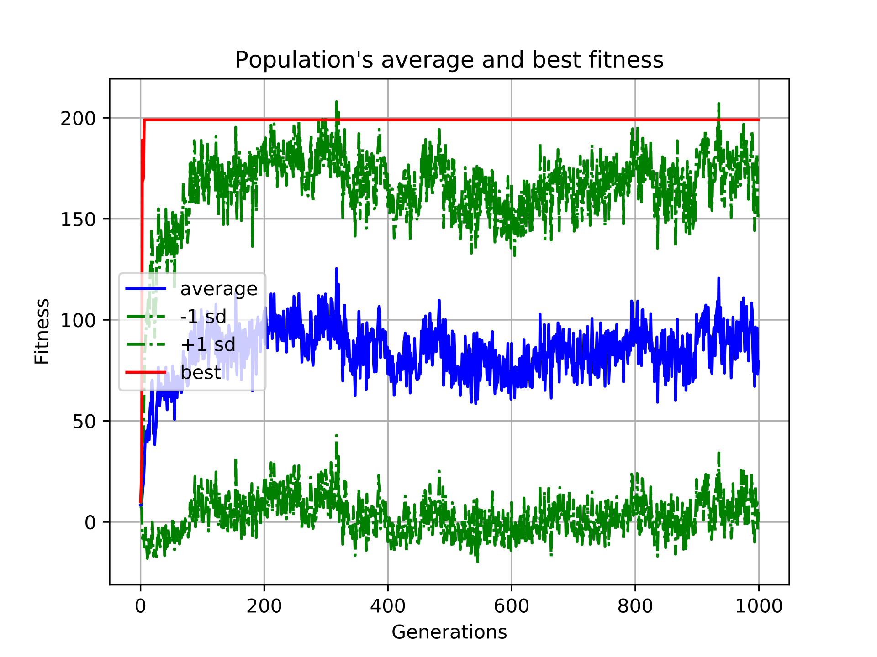
NEAT

Slide 10
Next Step
Learn and implement Q Learning algorithm
Compare training and testing speeds
Compare network complexity

